Slide 1
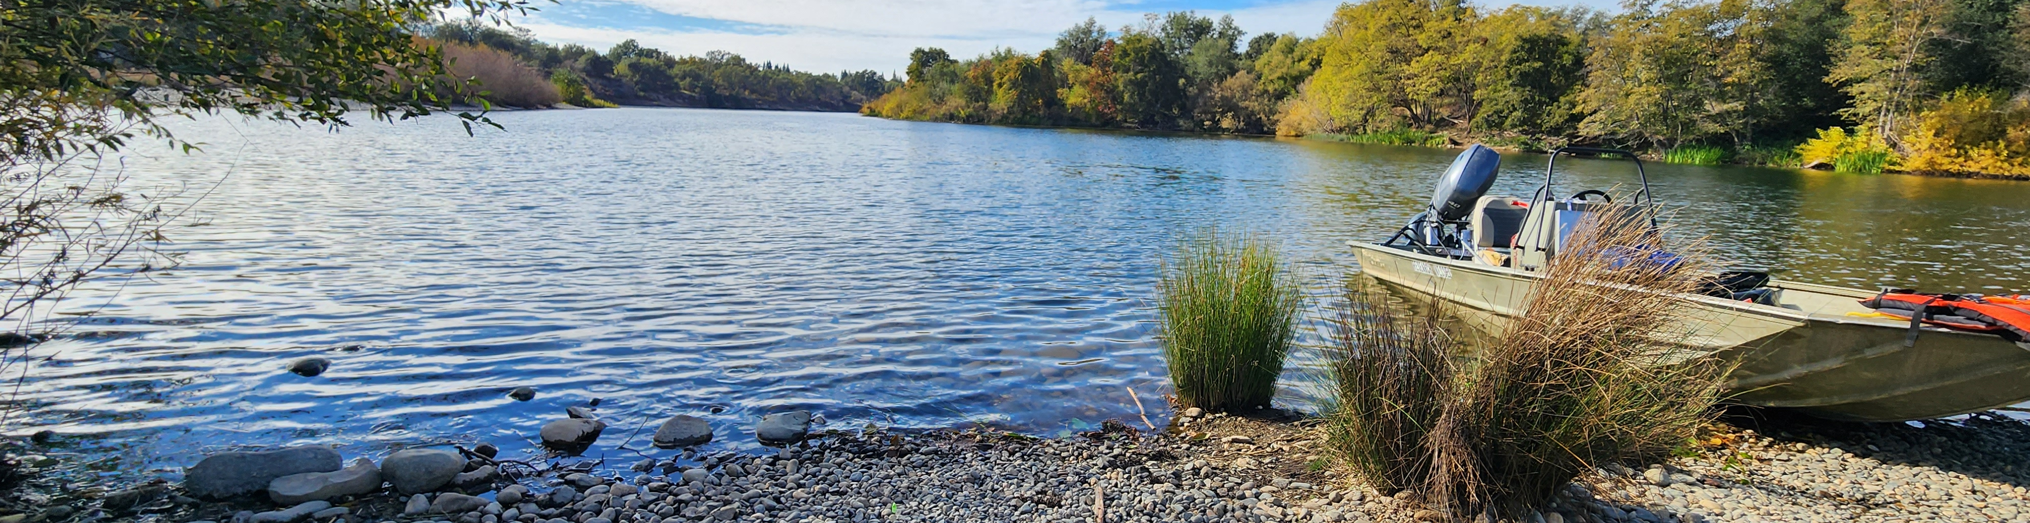

CVCS Escapement Modeling
Discussing Potential Changes to the CVCS Modeling Methods.
Presented by:
Arthur Barros, California Department of Fish and Wildlife
Arthur.Barros@wildlife.ca.gov

Slide 2
Session goals
Review modeling methods I still need to work on.
Review potential next steps for improving methods.
Discussion.

Slide 3
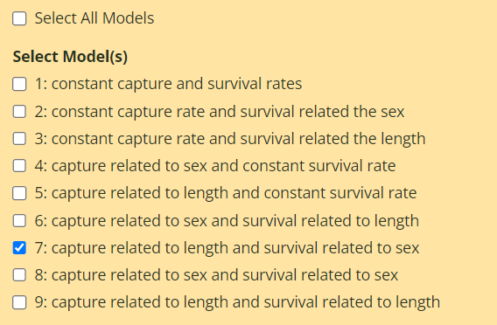
Things to do
Incorporate model comparison method.
Develop figure and estimate summary report.
Include unequal time between sampling periods.

Slide 4
Two big next steps
Increasing model complexity with additional covariates and various model structures.
Additional covariates: flow and turbidity
Non-linear models
Should we adopt R optim() based methods?

Slide 5
Potential complications
What are some potential issues of trying to adopt a new, potentially more complex, version of the model?
Is the decrease in speed worth the added customization, precision, and transparency of adopting an R optim() based method?

Slide 6
Questions and discussion

